Slide 1
Introduction to Machine Learning course
Lee-Ad Gottlieb
Ariel University

Slide 2
Course outline
Course requirements
4 or 5 homeworks (theory & programming)
Final project
Rough outline
⅓ math & probability
⅓ algorithms & proofs
⅓ heuristics

Slide 3
Course outline
Some parallel courses:
Mehryar Mohri (NYU)
Aryeh Kontorovich (BGU)
Avrim Blum (CMU)
See webpage
Suggested books – all free!
Understanding Machine Learning.
Foundations of Machine learning.
Neural Networks and Deep Learning

Slide 4
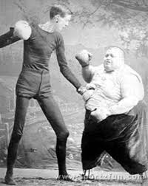
What is machine learning?
Draw conclusions from data
Predict unknown properties
Usually from a sample
For example
Given someone’s height,
can you guess the weight?
Given someone’s temperature and heartrate
can you guess the gender?
Let’s look at some UCI datasets…

Slide 5
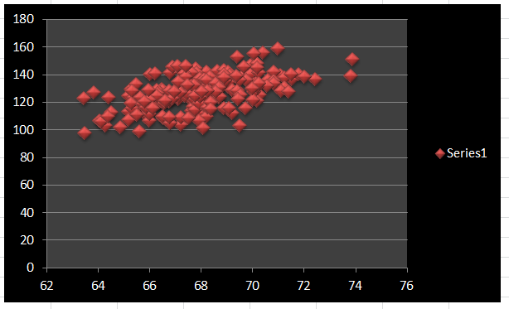
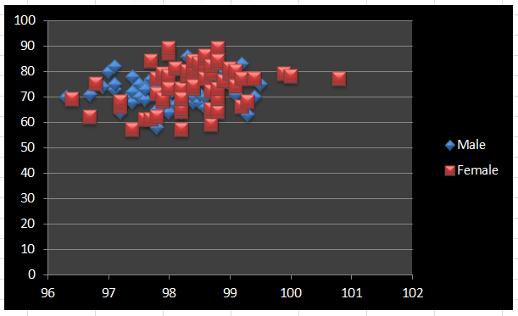
What is machine learning?
weight vs. height
Temperature & heartrate

Slide 6
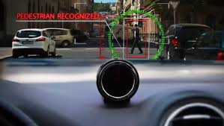
What is machine learning?
More examples:
Spam detection
Mail server has datasets of millions of items that users labelled as spam
Can it extrapolate to new email?
Face or image recognition
Google has massive datasets
Can you extrapolate to life?

Slide 7
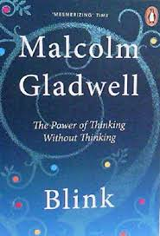
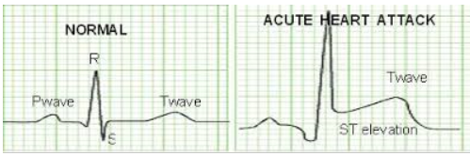
What is machine learning?
More examples: Automatic EKG reading
Consult experts to build model?
Are there experts?
If there are, do they know the rules?
Not robust.
Goal: Have computer learn it automatically, without any help

Slide 8


What is machine learning?
Last example: Netflix Prize
https://en.wikipedia.org/wiki/Netflix_Prize

Slide 9
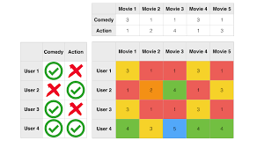
What is machine learning?
Netflix Prize: An example of recommender systems
Key technique: Principal Component Analysis (PCA)

Slide 10
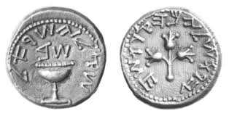
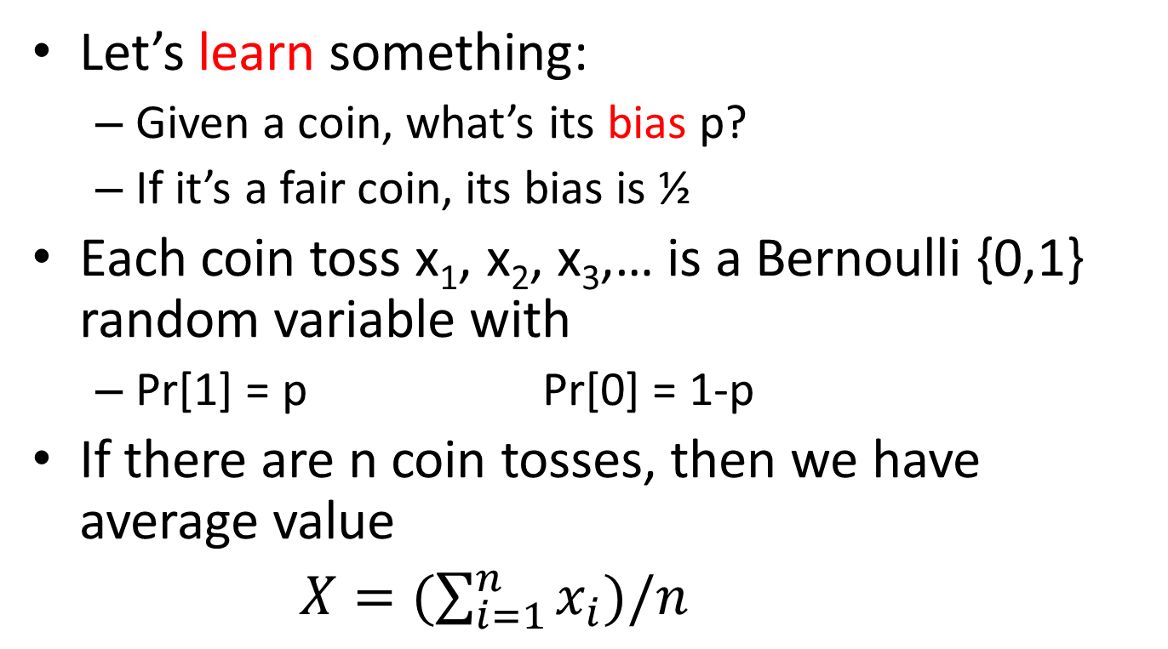
Coin bias
Let’s learn something:
Given a coin, what’s its bias p?
If it’s a fair coin, its bias is ½
Each coin toss x₁, x₂, x₃,… is a Bernoulli {0,1} random variable with
Pr[1] = p Pr[0] = 1-p
If there are n coin tosses, then we have average value
$X=(\sum_{i=1}^{n}{x_{i}})/n$

Slide 11
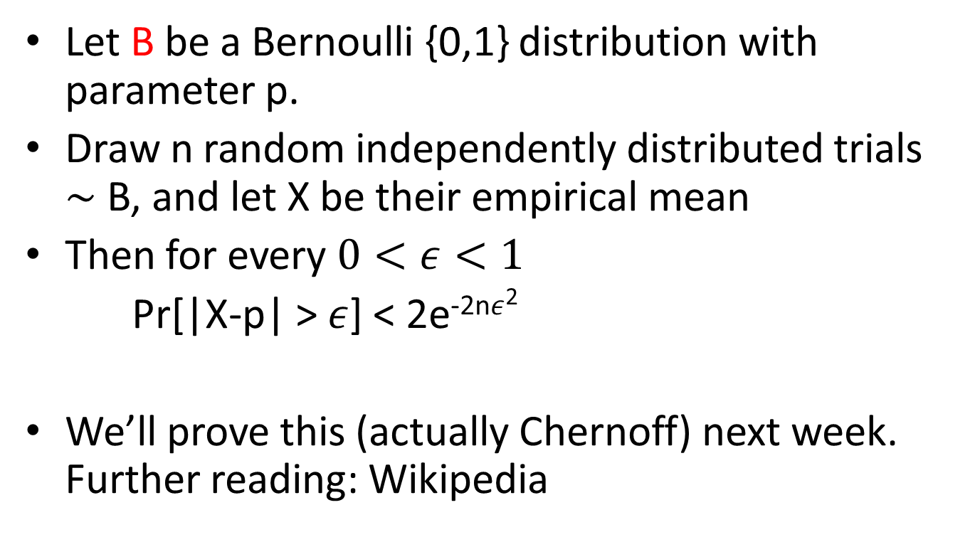
Hoeffding’s inequality
Let B be a Bernoulli {0,1} distribution with parameter p.
Draw n random independently distributed trials $\sim$ B, and let X be their empirical mean
Then for every $0<ε<1$
Pr[|X-p| > $ε$] < 2e^{-2n}$ε$²
We’ll prove this (actually Chernoff) next week. Further reading: Wikipedia

Slide 12
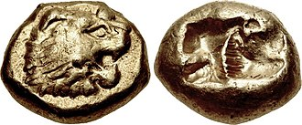
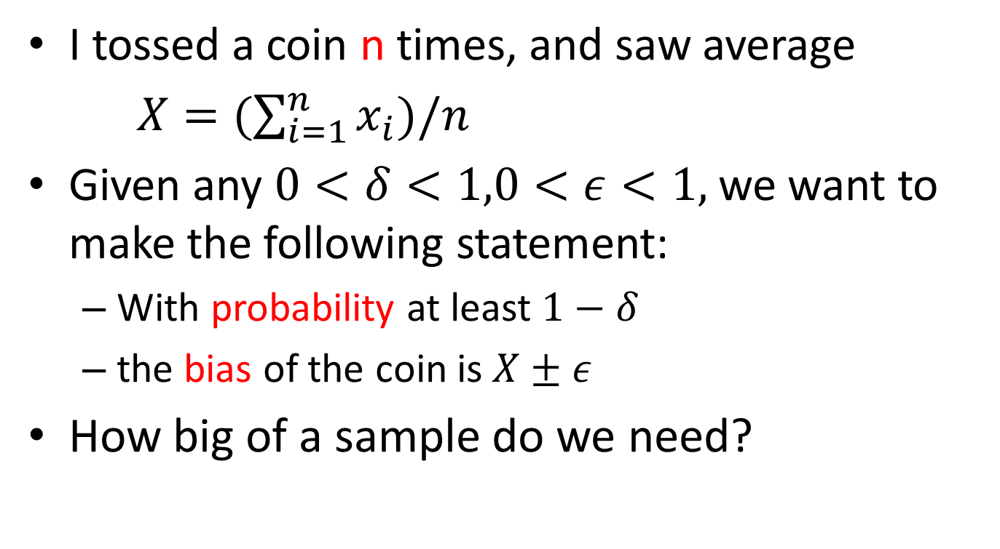
Coin bias
I tossed a coin n times, and saw average
$X=(\sum_{i=1}^{n}{x_{i}})/n$
Given any $0<δ<1,0<ε<1,$we want to make the following statement:
With probability at least $1−δ$
the bias of the coin is $X±ε$
How big of a sample do we need?

Slide 13
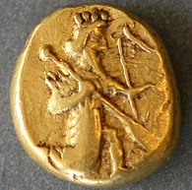
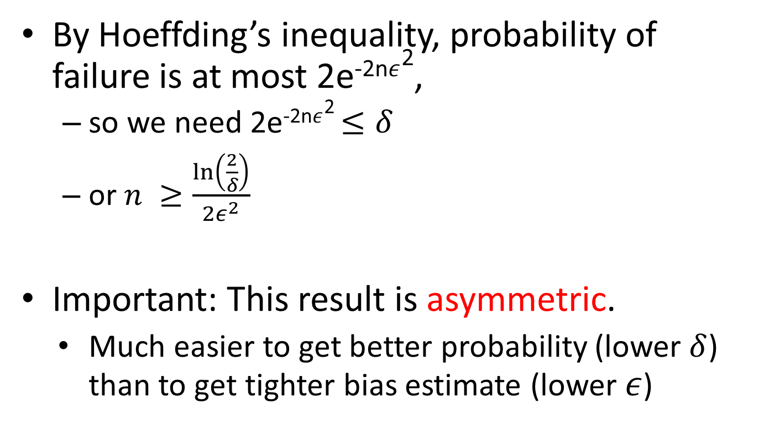
Coin bias
By Hoeffding’s inequality, probability of failure is at most 2e^{-2n}$ε$²,
so we need 2e^{-2n}$ε$² $≤δ$
or $n ≥\frac{\ln\left(\frac{2}{δ}\right)}{2ε^{2}}$
Important: This result is asymmetric.
Much easier to get better probability (lower $δ$) than to get tighter bias estimate (lower $ε$)

Slide 14

Coin bias
By Hoeffding’s inequality, probability of failure is at most 2e^{-2n}$ε$²,
so we need 2e^{-2n}$ε$² $≤δ$
or $n ≥\frac{\ln\left(\frac{2}{δ}\right)}{2ε^{2}}$
Important: This result is asymmetric.
Much easier to get better probability (lower $δ$) than to get tighter bias estimate (lower $ε$)
2e^{-2n}$ε$² $≤δ$
$$−2nε^{2}≤\ln{(δ\text{/}\text{2}\text{) }}$$
$$n≥−\frac{\ln{(δ\text{/}\text{2}\text{)}}}{{2ε}^{2}}$$
$$n≥\frac{\ln{(2/δ\text{)}}}{{2ε}^{2}}$$

Slide 15
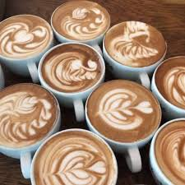
Memorizer
Let’s do an example that gets to the heart of learning: The Memorizer.
Suppose you work at a coffee shop
You have a week in which you’re allowed to ask the patrons whether they want coffee or tea (1 or 0)
After the first week you need to know what they want without asking
Only get paid if you’re right
Abstract learning problem
waiter = learner
first week customers = sample
drink = label
payment = measure of success

Slide 16

Memorizer
What’s a good rule?
Let’s try memorizing!
For every patron in the first week, write down their name and preference.
If someone on the list comes again, give them the same drink.
If a new patron comes in, give them a random drink
Is this a good idea?

Slide 17
Memorizer
Memorizer success
On the sample: 100%
On the world: 50%
Bad idea!

Slide 18

Memorizer
What’s a good rule?
Suppose you noticed that out of all the hundreds of customers in the first week
95% of men ordered tea
95% of women ordered coffee
How ‘bout this rule:
If customer is female, serve coffee. Otherwise serve tea.
Success:
On the sample: 95%
On the world: ?

Slide 19
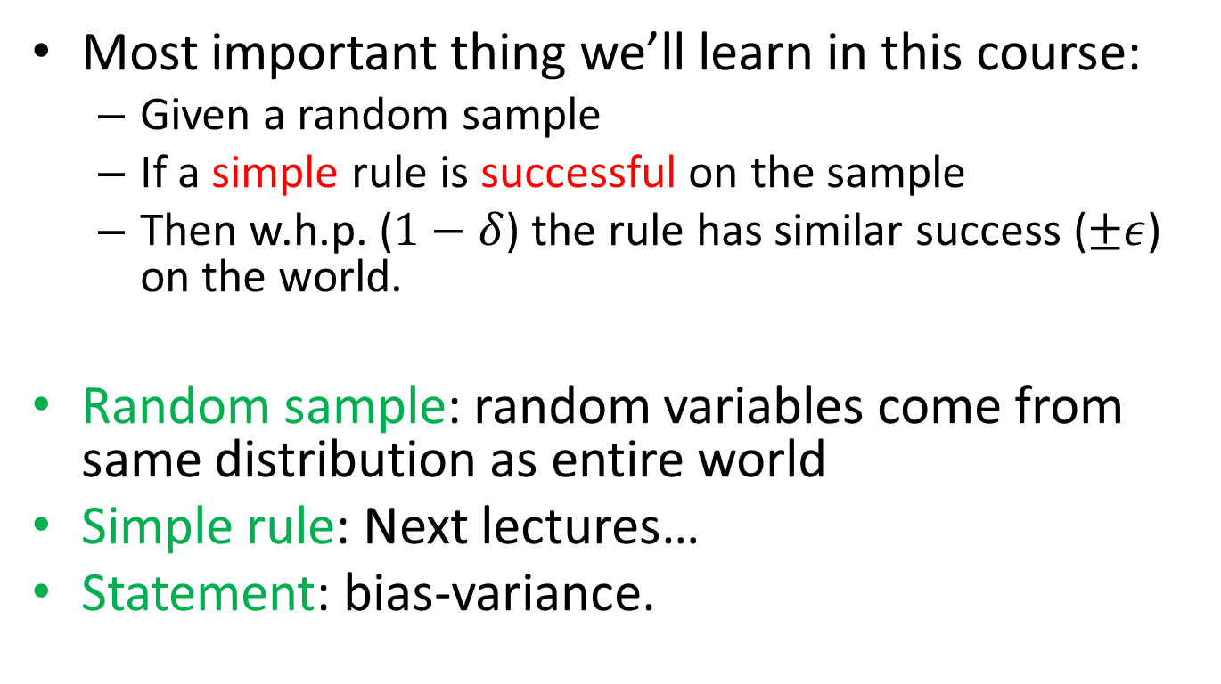
Memorizer
Most important thing we’ll learn in this course:
Given a random sample
If a simple rule is successful on the sample
Then w.h.p. ($1−δ$) the rule has similar success ($±ε$) on the world.
Random sample: random variables come from same distribution as entire world
Simple rule: Next lectures…
Statement: bias-variance.

Slide 20
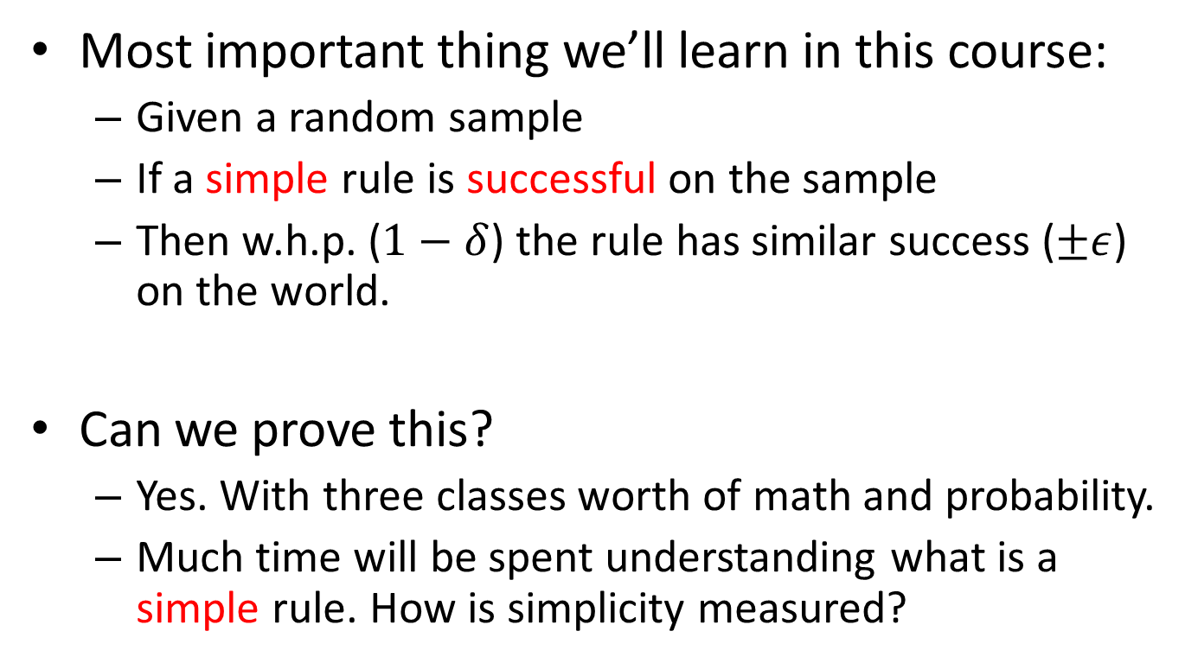
Memorizer
Most important thing we’ll learn in this course:
Given a random sample
If a simple rule is successful on the sample
Then w.h.p. ($1−δ$) the rule has similar success ($±ε$) on the world.
Can we prove this?
Yes. With three classes worth of math and probability.
Much time will be spent understanding what is a simple rule. How is simplicity measured?

Slide 21
Overfitting
But what if I find a complex rules that explains the sample well?
Like memorizing…
Overfitting
Learning the sample, not understanding the underlying rule behind the sample

Slide 22
Learning goals
Classification
Multiclass
Regression
Ranking
Clustering
Dimensionality reduction

Slide 23
Learning goals
Classification – discrete values
Multiclass
Regression
Ranking
Clustering
Dimensionality reduction

Slide 24
Learning goals
Classification
Multiclass – ex: website topics
Regression
Ranking
Clustering
Dimensionality reduction

Slide 25
Learning goals
Classification
Multiclass
Regression – continuous values: weight/height
Ranking
Clustering
Dimensionality reduction

Slide 26
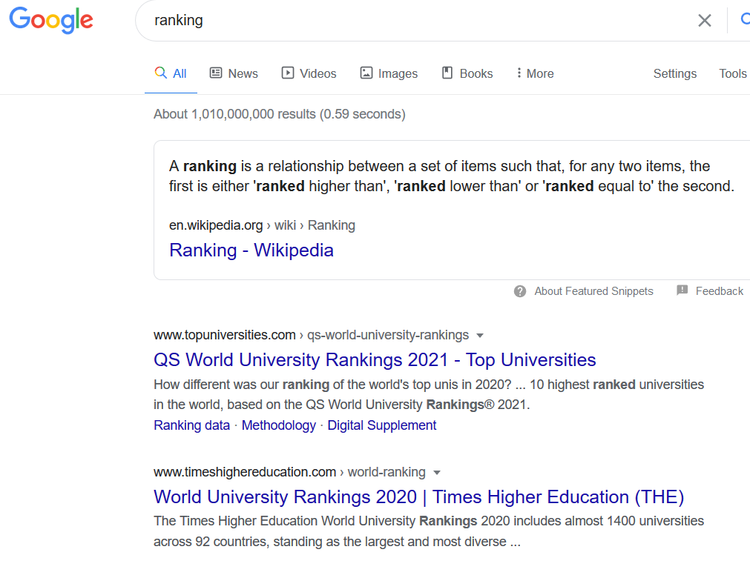
Learning goals
Classification
Multiclass
Regression
Ranking – Google search
Clustering
Dimensionality reduction

Slide 27
Learning goals
Classification
Multiclass
Regression
Ranking
Clustering – unsupervised learning
Dimensionality reduction

Slide 28
Learning goals
Classification
Multiclass
Regression
Ranking
Clustering – unsupervised learning (ex: ads)
Dimensionality reduction

Slide 29
Learning goals
Classification
Multiclass
Regression
Ranking
Clustering
Dimensionality reduction - PCA

Slide 30
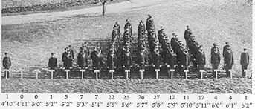
Review of probability
Probability distribution: Description of the probability of every possible event
Coins f(H,T) → {½,½}
Dice f(1,2,3,4,5,6) → {⅙, ⅙, ⅙, ⅙, ⅙, ⅙}
Height Normal

Slide 31
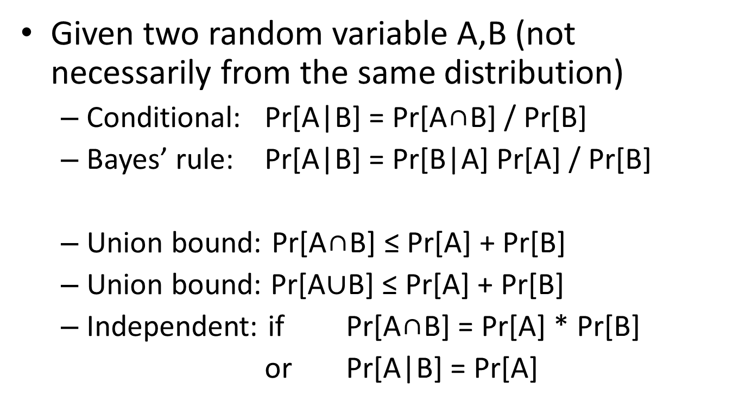
Review of probability
Given two random variable A,B (not necessarily from the same distribution)
Conditional: Pr[A|B] = Pr[A∩B] / Pr[B]
Bayes’ rule: Pr[A|B] = Pr[B|A] Pr[A] / Pr[B]
Union bound: Pr[A∩B] ≤ Pr[A] + Pr[B]
Union bound: Pr[A$∪$B] ≤ Pr[A] + Pr[B]
Independent: if Pr[A∩B] = Pr[A] * Pr[B]
or Pr[A|B] = Pr[A]

Slide 32
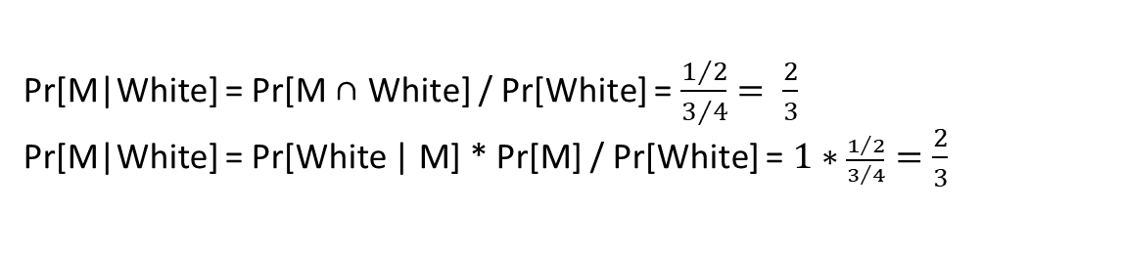
Review of probability
Horse | Win % | Gender | color
Abe | 25% | M | White
Alice | 25% | F | White
Bob | 25% | M | White
Betty | 25% | F | Black
Pr[M|White] = Pr[M ∩ White] / Pr[White] = $\frac{1/2}{3/4}= \frac{2}{3}$
Pr[M|White] = Pr[White | M] * Pr[M] / Pr[White] = $1∗\frac{1/2}{3/4}=\frac{2}{3}$

Slide 33
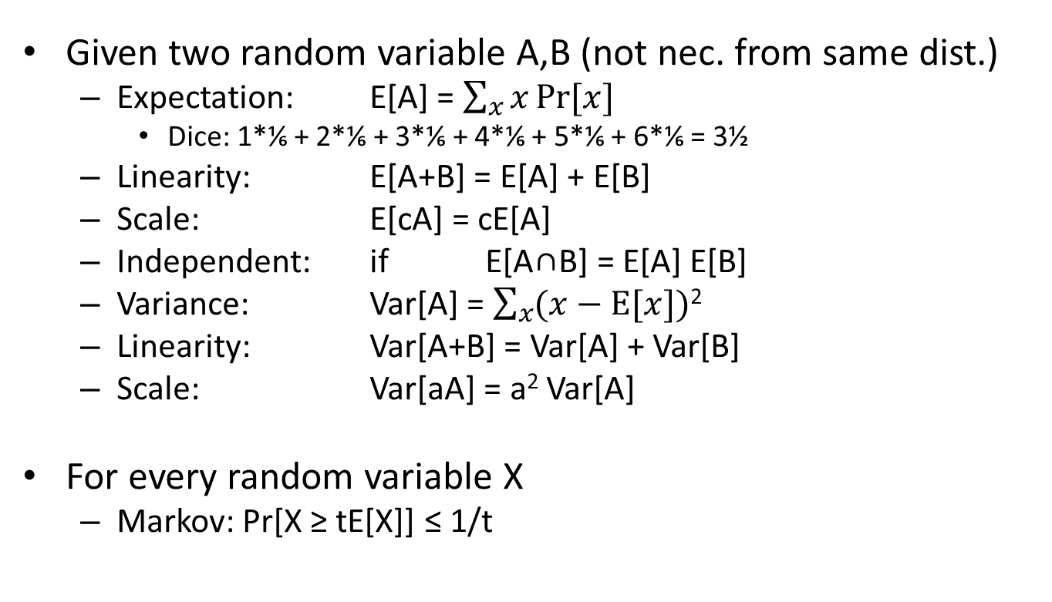
Review of probability
Given two random variable A,B (not nec. from same dist.)
Expectation: E[A] = $\sum_{x}{x}Pr⁡[x]$
Dice: 1*⅙ + 2*⅙ + 3*⅙ + 4*⅙ + 5*⅙ + 6*⅙ = 3½
Linearity: E[A+B] = E[A] + E[B]
Scale: E[cA] = cE[A]
Independent: if E[A∩B] = E[A] E[B]
Variance: Var[A] = $\sum_{x}{(x}−E⁡[x])\text{2}$
Linearity: Var[A+B] = Var[A] + Var[B]
Scale: Var[aA] = a² Var[A]
For every random variable X
Markov: Pr[X ≥ tE[X]] ≤ 1/t

